Slide 1
Preservation of the dark and quiet sky
Piero Benvenuti
Interim IAU General Secretary

Slide 2
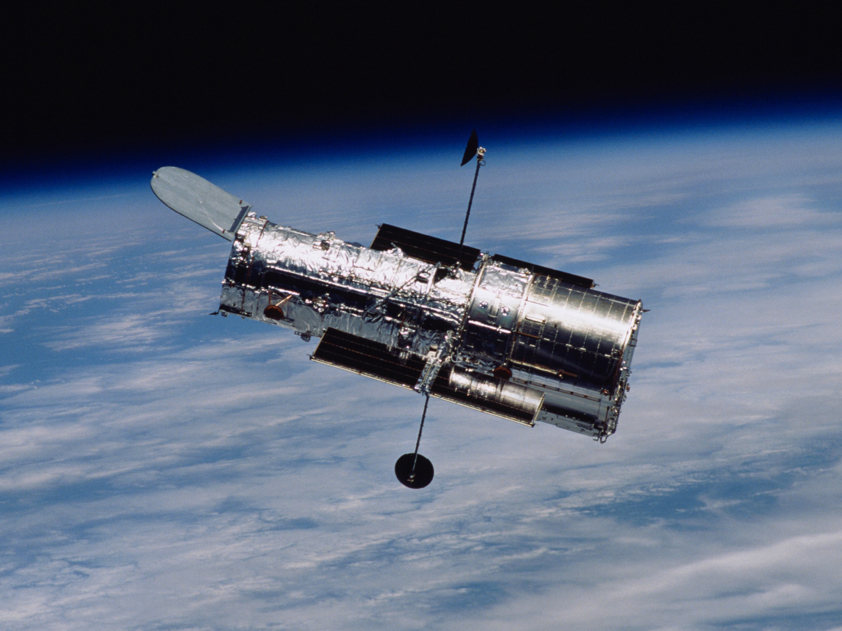
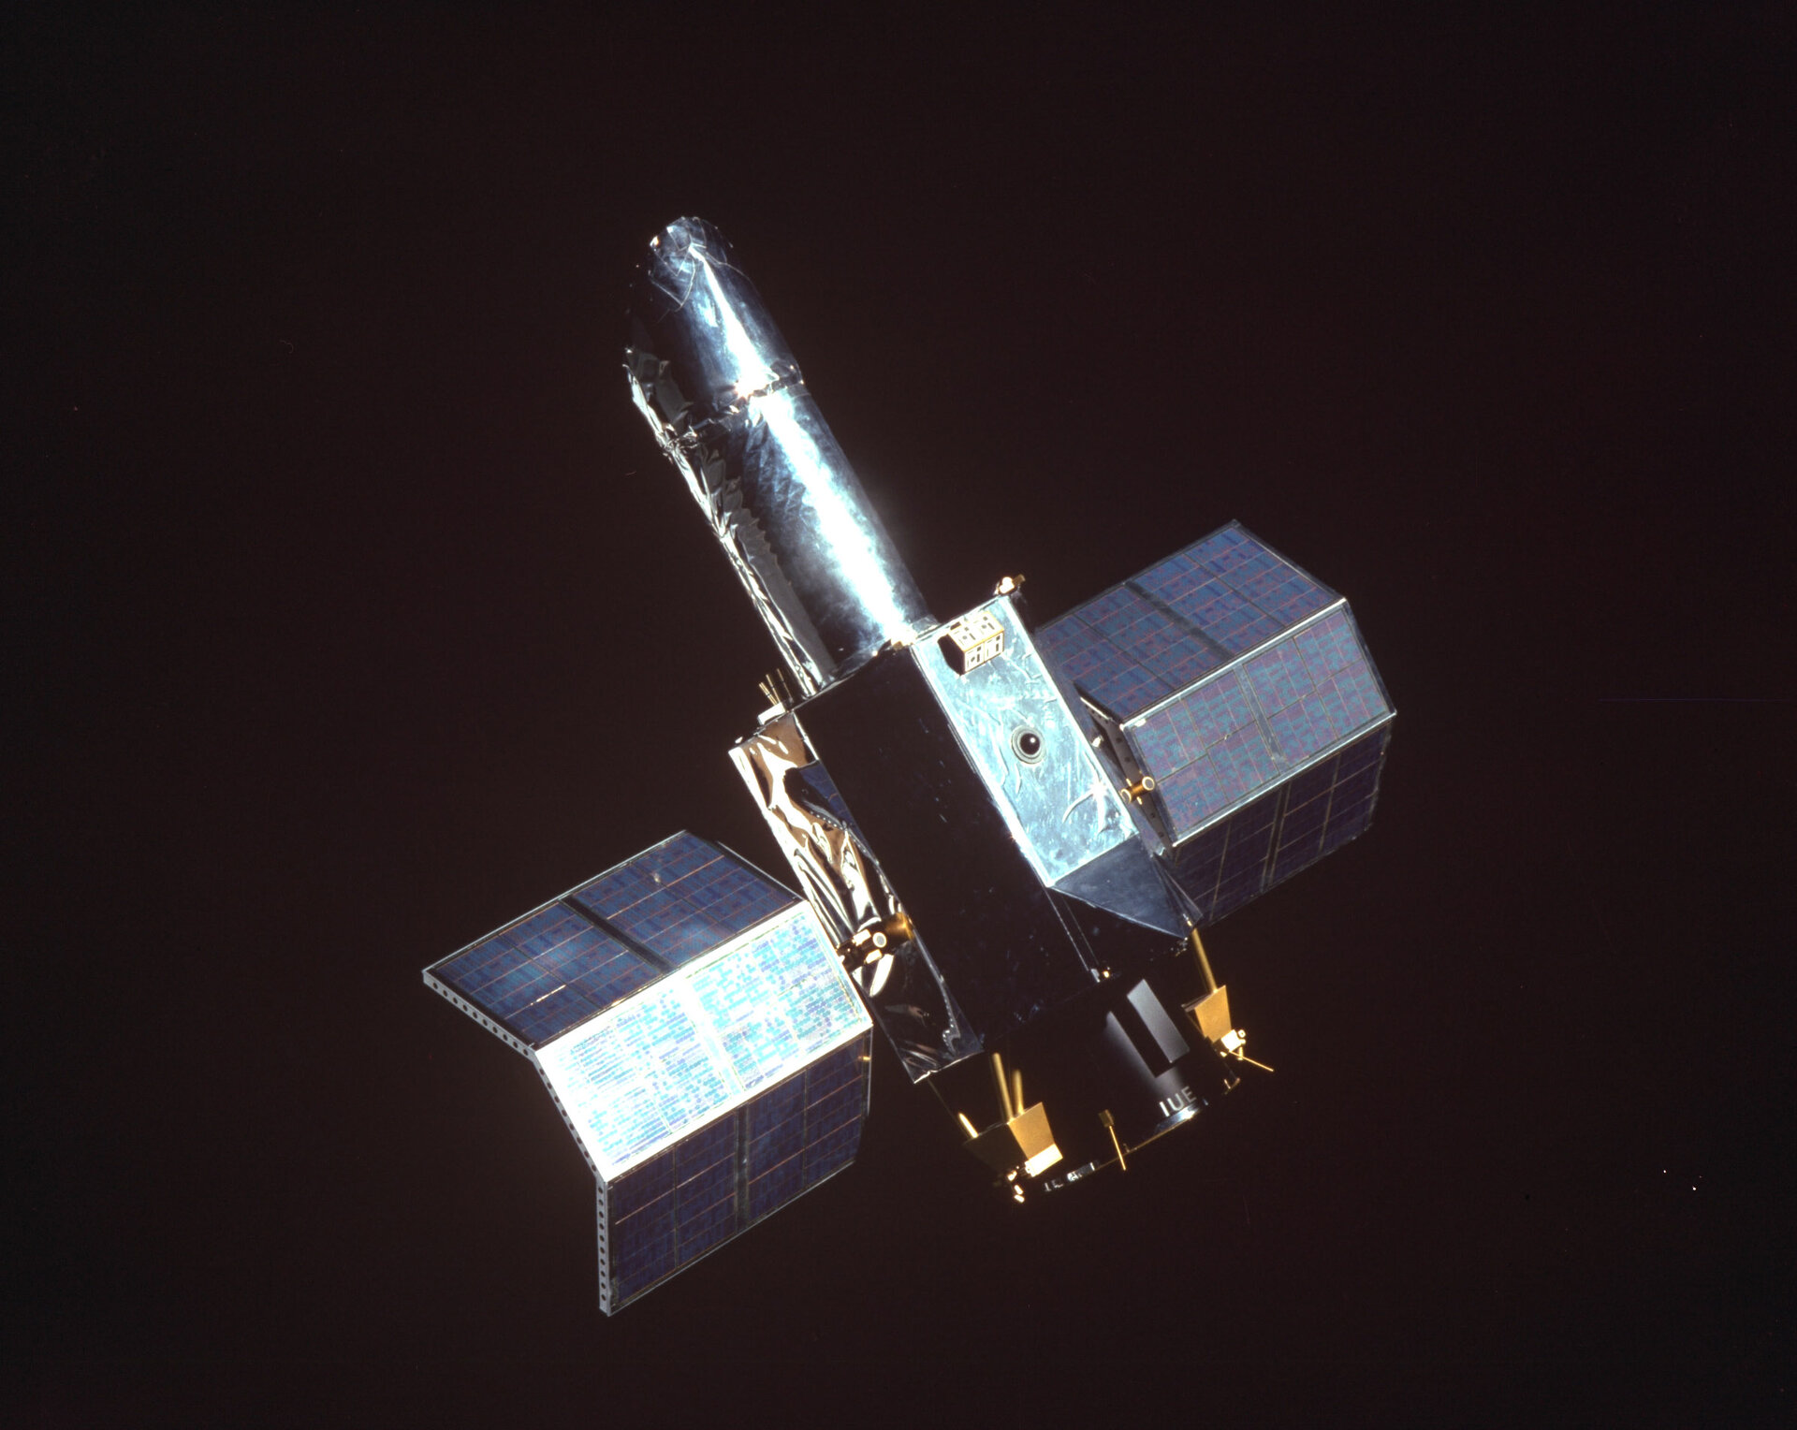
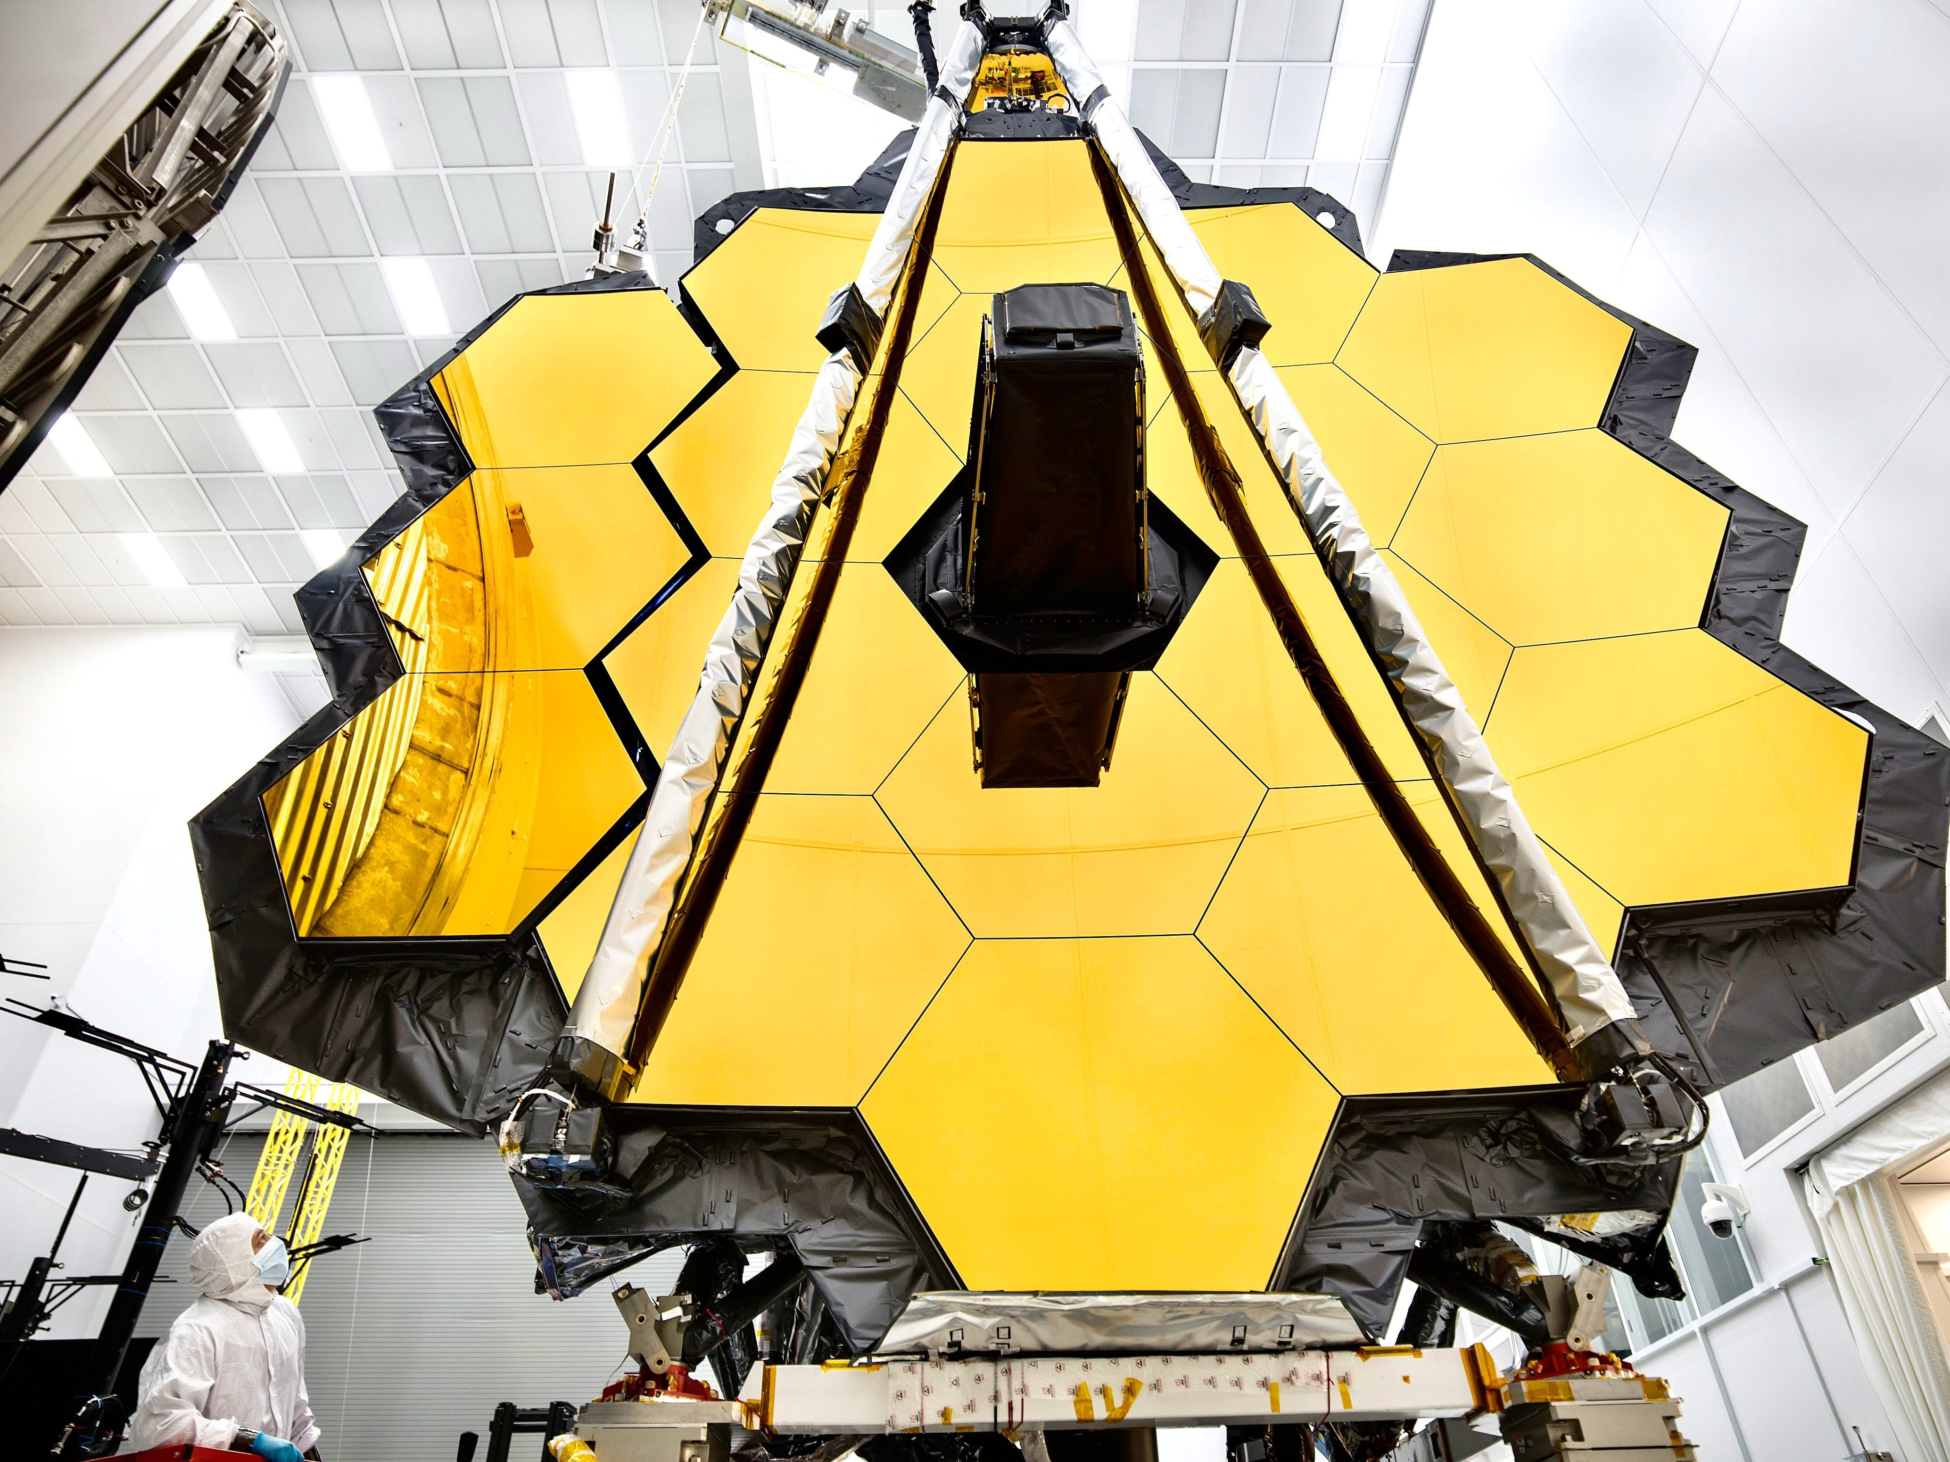
Astronomy and Space technology
Astronomy and Cosmology are very much indebted to space technology…however…

Slide 3
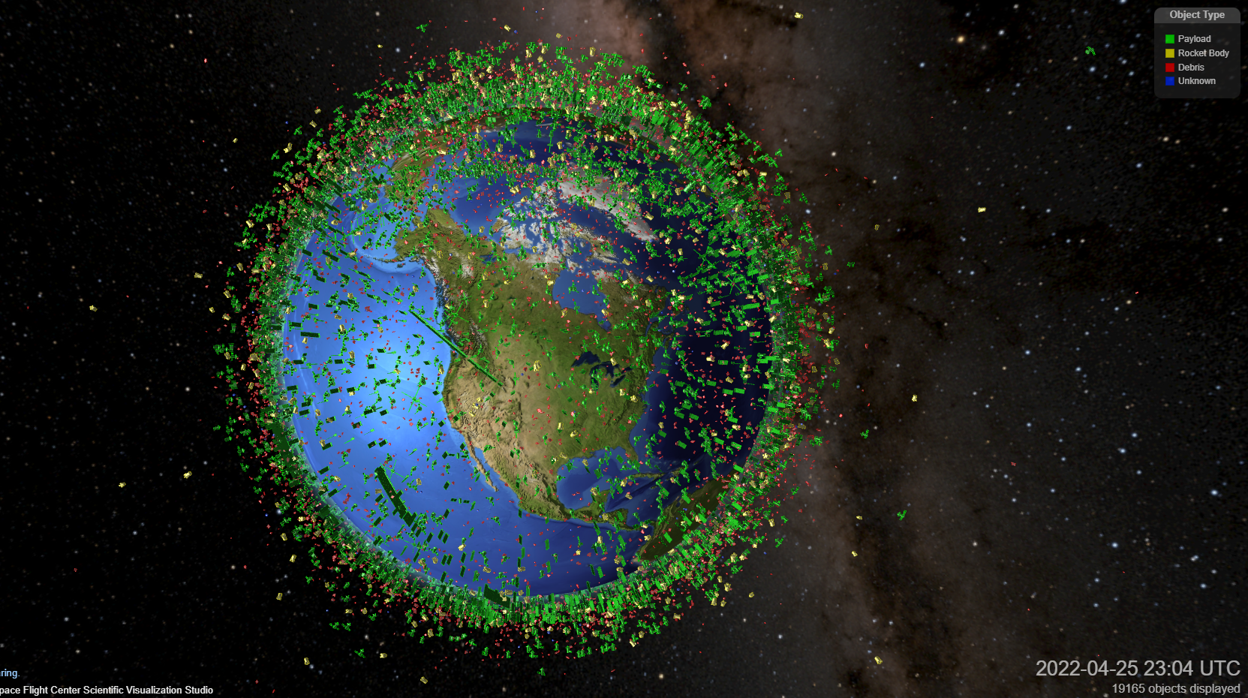
A new space era?
Today, the same space technology and the New Space Economy (NSE) are threatening them
Notes:
May want to update this slide with slide#3 (or any other recommendation?)

Slide 4
What has changed and why?
Until recently space was the domain of National and International Space Agencies
Using taxpayers’ resources, they had as goals scientific/technological advancements and space exploration
Today space is becoming the domain of private companies that have profit as their unique objective
The very nature of the threats calls for innovative mitigating measures
The large satellite constellations are just a first example of the possible threats of the New Space Economy…

Slide 5
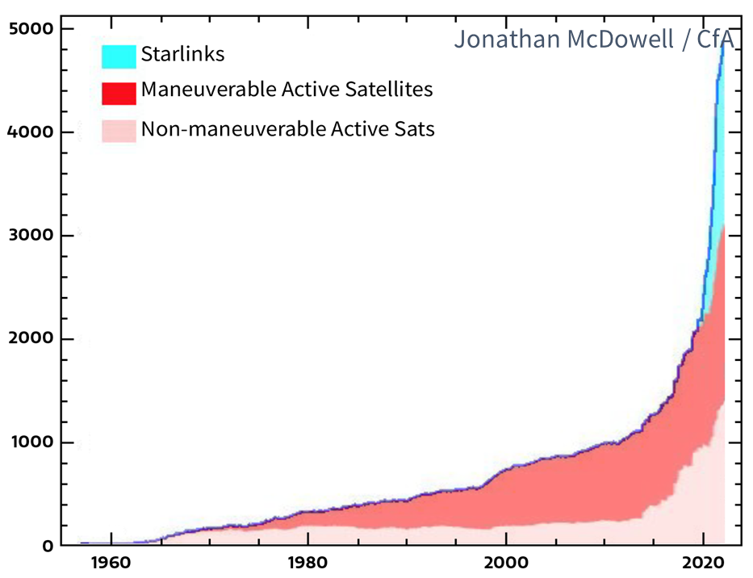
The root of the problem: an exponential increase in space activity
Active Satellites
2019 May 1: ~2,200
2023 Nov 1: ~6,800 (3x in 4 years)
Active+Inactive Satellites ~10,000
Trackable space junks ~30,000
Disturbing Reality: ~ 420,000 constellation satellites are planned (according to FCC+ITU application)

Slide 6
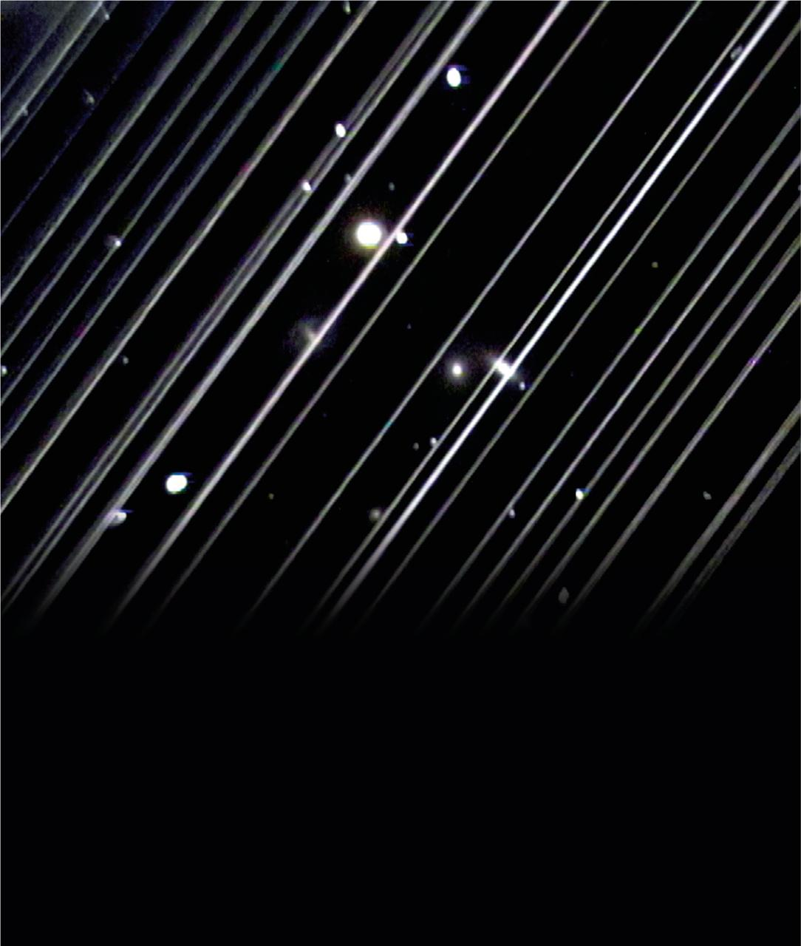
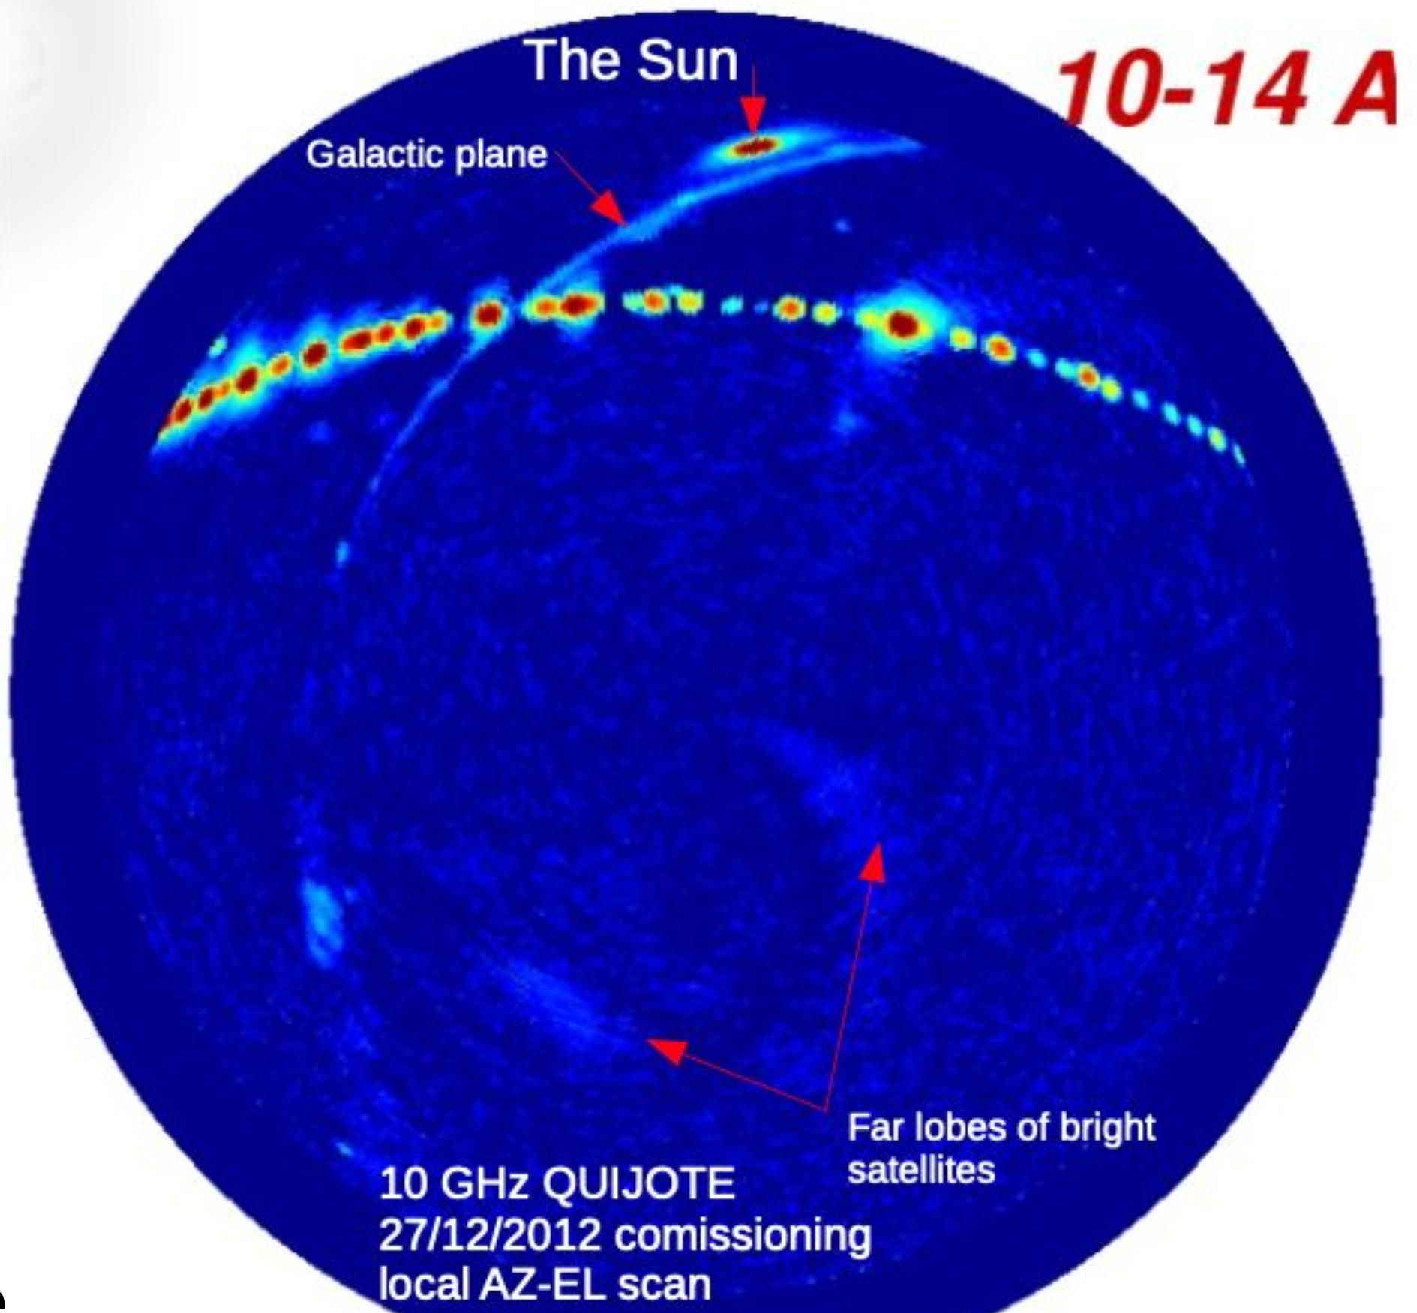
Why do satellites interfere with astronomy?
Geostationary satellites in Ku band
They reflect sunlight
They emit microwave radiation
Source: Victoria Girgis/Lowell Observatory
Source: Robert Watson / JBCA - Mike Peel / IAC
Notes:
And of course you know that astronomical observatories can be affected, for optical telescopes it depends on the field of view of the instrument and its latitude, as shown in some recent papers, but some of the most advanced telescopes like the under construction LSST will see a lot of impact.
Sunlight reflection is an unintended product of a satellite being in space, but electromagnetic radiation is not. And this is a challenge for radio astronomy, while radio astronomy has been dealing with satellites for a very long time, this situation is quite different due to potentially large density of satellites in the sky. The radio aspect is a bit more complex than the optical reflection, where not only the locations of satellites is important but also in which frequency they operate and at which frequency is the radio telescope observing. Furthermore, antennas see satellites in any direction in the sky through their sidelobes and regardless of the time of day. on the right you see a radio image from QUIJOTE, a CMB experiment in 2010, and that string of pearls are stationary GEO satellites.

Slide 7
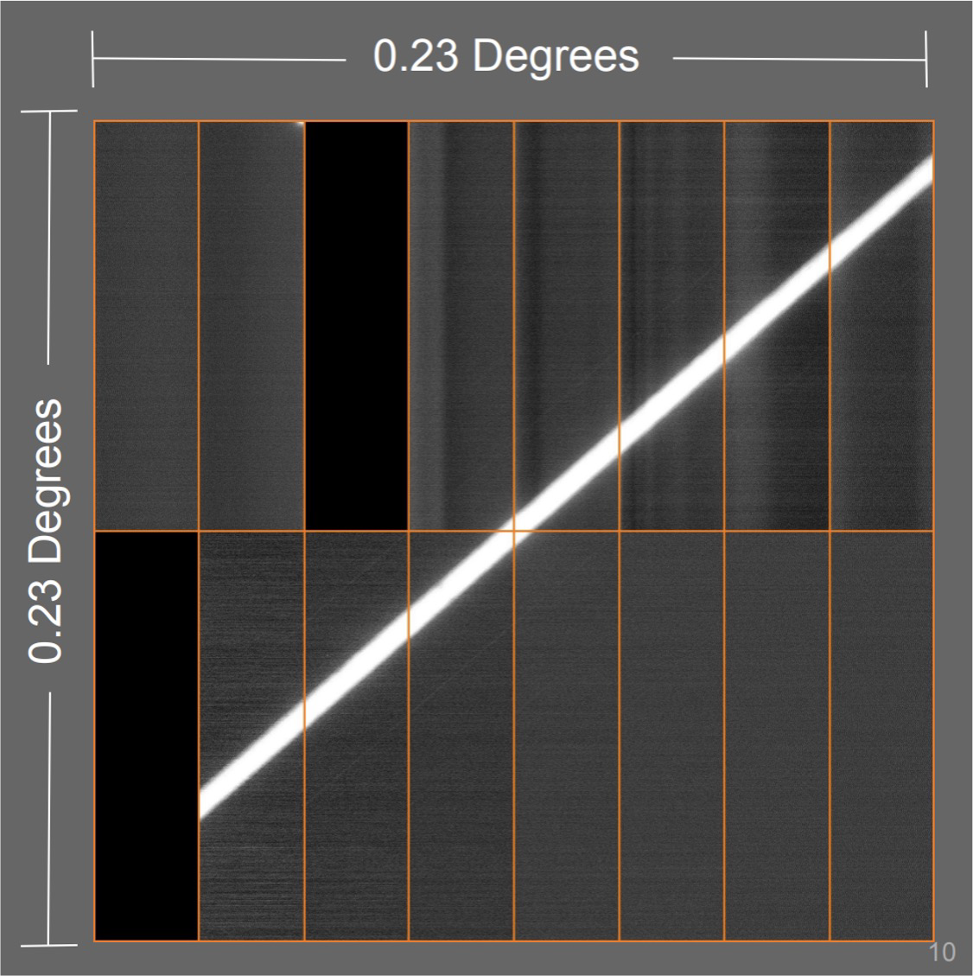
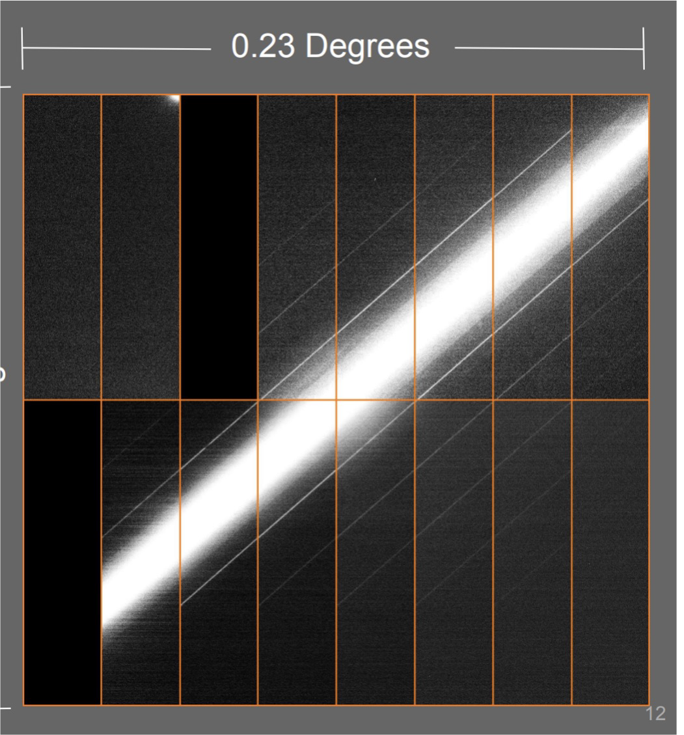
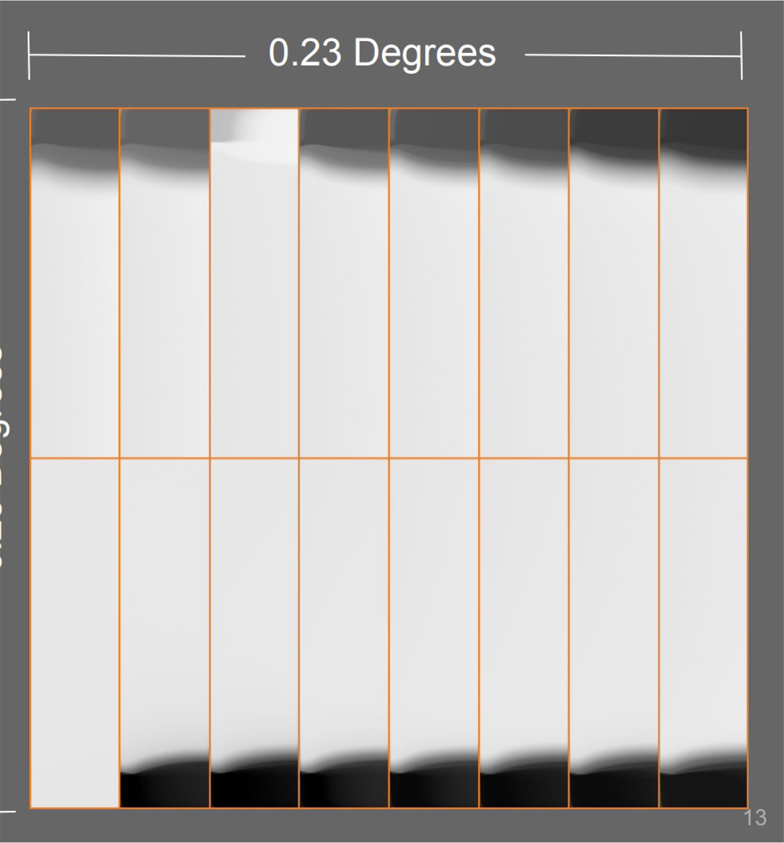
Rubin Observatory CCDs
Current Starlinks
IAU CPS recommendation BlueWalker 3
6

Slide 8
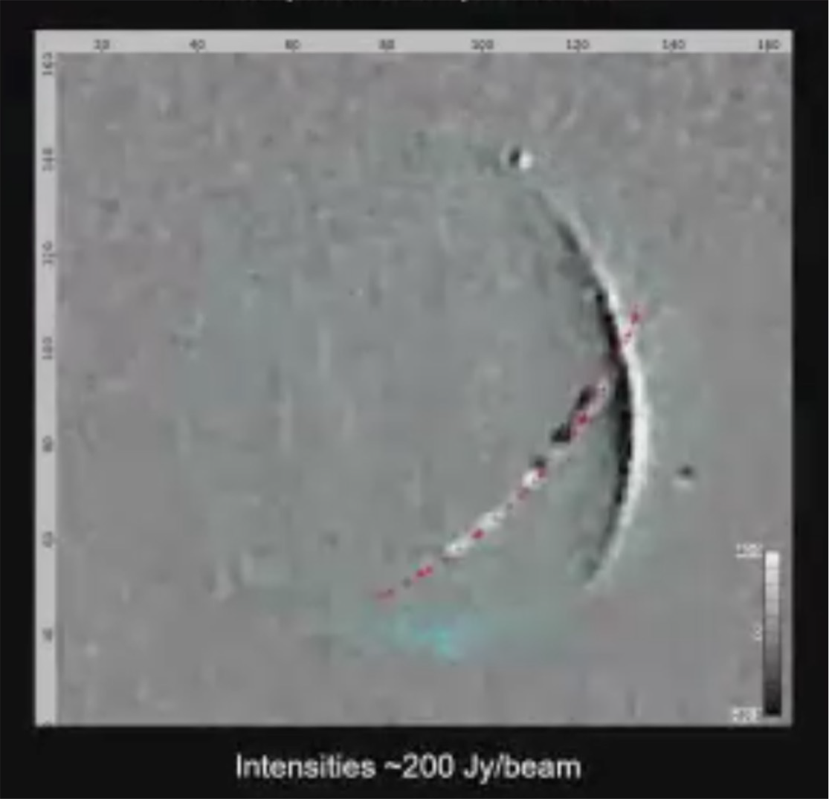
Radio interference
Ultra-bright beams from satellite downlinks
Unintended ElectroMagnetic Radiation (UEMR)
LOFAR detected UEMR radiation between 110 and 188 MHz
Unintended Starlink Emissions at SKA - Low (D. Grigg)

Slide 9
The IAU Mission and actions
The International Astronomical Union, founded in 1919, has today more than 13,000 individual Members from about 80 Countries.
Its main mission: to promote and safeguard the science of astronomy in all its aspects. The IAU could not have remained inert in front of the threats.
The two lines of attack:
International (voluntary) regulations (COPUOS)
A dedicated pragmatic action (CPS)
A line which was explicitly not endorsed: legal actions (albeit still pursued by some astronomical minorities)

Slide 10
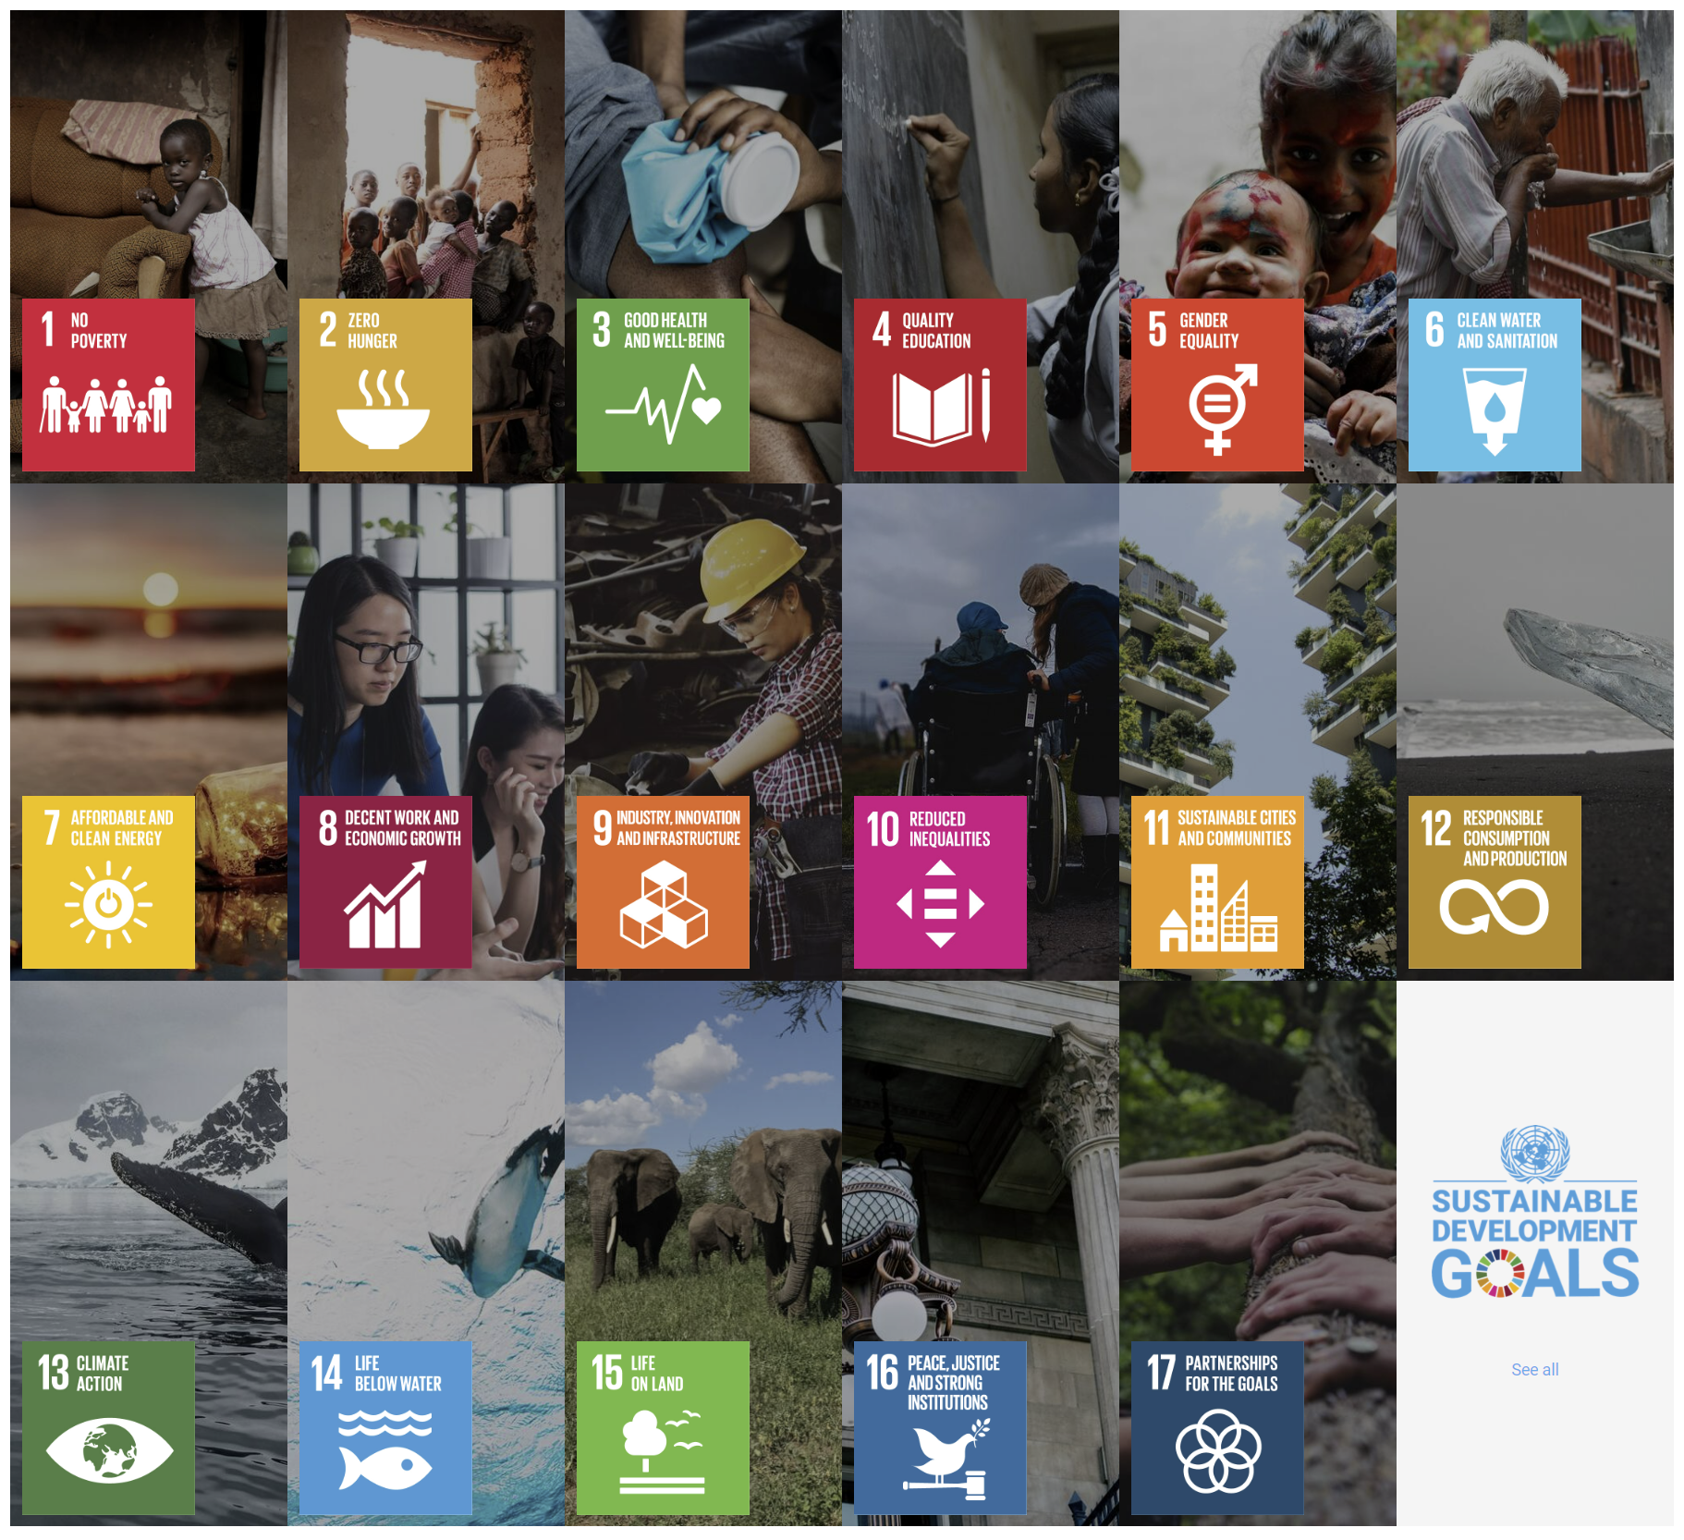
Internet connectivity for all
Access to internet is one of the targets of the UN SDGs
Satellite connectivity has proven to be an effective tool to provide internet to underserved areas
The IAU do not intend to hinder the operation of the communication satellite constellations
However, the interference of the constellations on astronomy and on the visibility of the sky has to be mitigated
Notes:
Access to the Internet is included in one of the targets within the UN Sustainable Development Goals.
Satellite connectivity has proven to be effective in providing internet to isolated communities, although there are still many questions about business models and cost of serivce, recent events
have shown that the techonlogy is mature enough to effectively connect people. We can take many examples as small communities in Canada or Alaska or the aid provided by SpaceX to Ukraine.

Slide 11
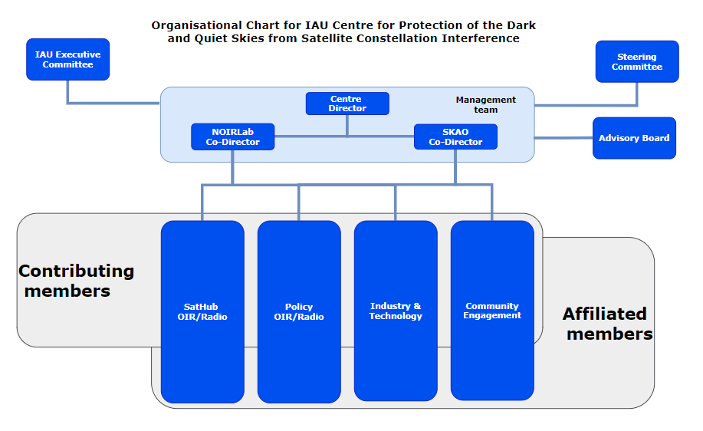
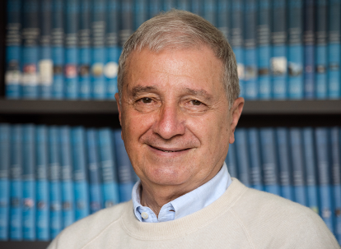
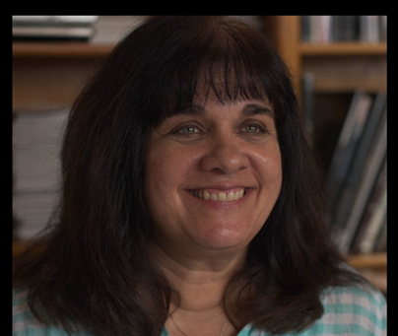
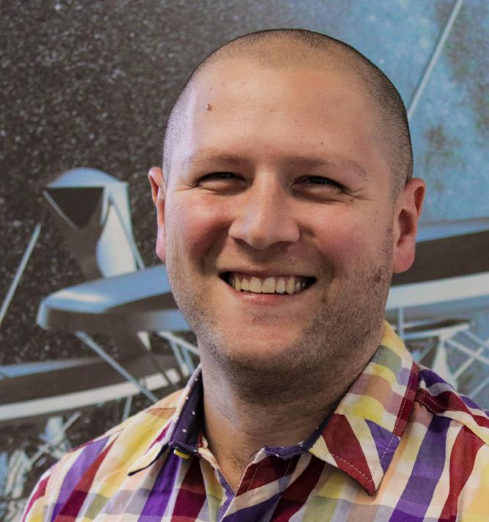
The IAU CPS (2022)
Richard Green
Andrew Williams
John Barentine
Jessica Heim
Chris Hofer
Tim Stevenson
Meredith Rawls Mike Peel

Slide 12
Is mitigation possible?
Satellites can be made less reflective:
The pristine vision of the night sky is preserved
The astronomical detectors are not saturated or damaged and the satellites’ trails can be partially removed by post processing
The apparent position of the satellites can be accurately predicted:
The astronomical observation can be interrupted during the passage of the satellites within the field of view of the telescopes
The radio emission of the satellites can be interrupted or deviated when passing over major radio-astronomical observatories
The wavelengths bands of radio-astronomical interest should continued to be protected (an ITU-R matter – more later)

Slide 13
Yes, but…
A strong collaboration with the satellites industries and private companies is needed.
Best practices have to be identified and voluntarily implemented.
Experience shows that companies are more amenable to implement them if they become knowledgeable in the early phase of the constellation design
The IAU CPS is working along these lines with, until now, satisfactory results.
However, the situation is in fast evolution, involving more Countries and possibly larger and more impacting satellites.
In order to remain effective, the best practices need to be acknowledged and supported by the Governments from which the companies depend.

Slide 14
COPUOS and STSC 2020-2024
•COPUOS: COmmittee for the Peaceful Use of Outer Space
•STSC: Scientific and Technical SubCommittee
•LSC: Legal SubCommittee
•57th STSC (2020) – Technical Presentation
•Raising attention
•58th STSC (2021) – CPR (Chile, Ethiopia, Jordan, Slovakia, Spain, IAU, ESO, SKAO) and Technical Presentation (C. Walker)
•Positive support by 18 Delegations, dedicated Item in the Agenda of STSC 59th
•59th STSC (2022) – WP (Austria, Chile, Dominican Republic, Slovakia, Spain, IAU, ESO, SKAO)
•25 intervention under the dedicated Agenda Item
•Astronomy is instrumental to space activities, its protection is within the COPUOS remit
•The constellations’ impact is serious and requires the cooperation of all stakeholders
•The dedicated Item shall be maintained in the Agenda of STSC 60th
•65th COPUOS (2022) – The CPS presented
•Very positive comments by about 15 Delegations (including China for the first time)

Slide 15
60th STSC (2023): CRP on the Protection of Dark and Quiet Skies for science and society (Presented by Chile, Spain, Slovakia, Bulgaria, Dominican Republic, Peru, South Africa, IAU, ESO and SKAO)
Keeping the D&Q_S Agenda Item for a minimum of 3 more years
Creation of a COPUOS Expert Group on D&Q_S
The CRP got the support of ~ 50 Delegations
No consensus on the scope of the Agenda item (opposition by Russian Fed. and Iran)
Group of Friends created by an initiative of Chile and Spain
61th STSC (2024): Agenda Item approved for 5 years.
“Dark and Quiet Sky, astronomy and large constellations: discussion on emerging issues and challenges”

Slide 16
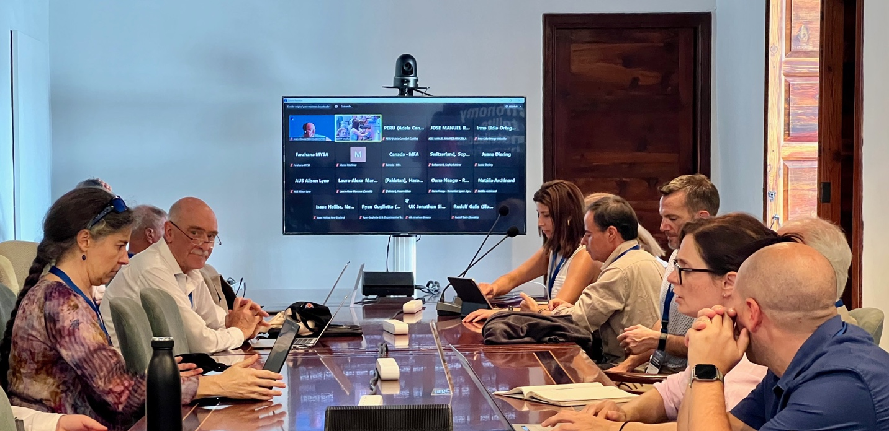
Group of Friends of D&Q_S
Aims of the Group of Friends:
Promote awareness
Review best practices and mitigation suggestions
Discuss the overall implications of the adoption of mitigating measures
Discuss approaches for coordination between the various stakeholders
Support the development of best practices
Currently adering Delegations and Observers:
Belgium, Bulgaria, Chile, Colombia, Germany, Italy, Luxembourg, Mexico, New Zealand, Rumania, Slovakia, South Africa, Spain, Switzerland, UK, USA
COSPAR, EAS, ESO, IAA, IAU, SKAO
GoF webpage: https://cps.iau.org/group-of-friends/

Slide 17
Conclusions
Let’s turn a problem into an advantage
Astronomy has never enjoyed the current visibility at UN level
We should use the favourable situation to convince policy makers and the society at large that:
Astronomy is absolutely instrumental for progressing in the understanding of reality
Cosmology and Cosmologia can help promoting peace and tolerance: not only we all live under the same sky, but we are the sky and its consciousness
In order to achieve that we should:
Critically review our outreach goals...
...and, since we are in the Vatican, follow the seminal thoughts of George Lemaître and Pierre Teilhard de Chardin

